Slide 1
What you need to know about
Medicaid changes for immigrants
A 30-minute training to get into the know
New Jersey | July 2026
New Jersey | July 2026
Based on HR1 / One Big Beautiful Bill Act

Slide 2
What we’ll cover today
30 minutes of training + 30 minutes for questions & discussion
1
THE BIG PICTURE What is HR1 and who is affected?
2
IMMIGRANT ELIGIBILITY Who keeps Medicaid, who loses it?
3
WHAT HAPPENS & WHEN Key dates and the notice process
4
6 STEPS TO KEEP COVERAGE Practical steps for immigrants
5
PRIVACY & SAFETY CONCERNS What immigrants need to know
6
CASE STUDIES Real scenarios to practice
Notes:
Renee:
Quick look at what's ahead. Six sections, 30 minutes, then 30 more for questions and just talking it out. Doesn't matter if you're a healthcare worker, social worker, community member, or an immigrant yourself — this is for you. We'll keep it plain and use real examples the whole way.

Slide 3
SECTION 1
The big picture
What is HR1 and who does it affect?
Notes:
Let's start with the big picture. This law got passed in Washington, and it's gonna change who qualifies for Medicaid starting this fall. Let's make sure we all understand what it actually is before we dig into the details.

Slide 4
Medicaid in New Jersey: The scale
Nearly 1 in 5 NJ residents depends on Medicaid.
1.8M
1 in 5
829K
800K
NJ Residents
on Medicaid
NJ Residents
are covered
Children
covered
Residents may
lose Medicaid or ACA Marketplace coverage by 2028
⚠ Already, 69,000 people have left the ACA Marketplace since January 2026. These changes are happening now.
Sources: NJ FamilyCare (November 2025), KFF, US Census 2024
Notes:
Almost 1 in 5 people in New Jersey are on Medicaid. That's not a stat — that's your neighbors, your patients, your clients, your family. Up to 800,000 people could lose Medicaid or Marketplace coverage by 2028. And that's not just immigrants — it also includes low-income adults who'll face new work requirements starting in 2027. We'll touch on that later so it's on your radar, but today we're focused on immigrants.
Almost 69,000 people in New Jersey already dropped their Marketplace coverage since January, mostly because the extra help paying for it went away. This is moving fast.

Slide 5
What is HR1?
The law
Medicaid in NJ
HR1 is a new federal law — also called the "One Big Beautiful Bill Act" (OBBBA). It was made by Congress in Washington, D.C. and was intentionally designed to reduce the number of people on Medicaid
In New Jersey, Medicaid is called NJ FamilyCare. The state has to follow the new rules set by the federal government.
What changes
What stays the same
Starting October 2026, some adults will no longer qualify for Medicaid. NJ FamilyCare is sending letters to 25,000 adults asking them to submit paperwork to show they still qualify. This training focuses on immigrants.
Children and lawfully present
pregnant people are protected. This
training explains who is — and isn't — affected.
Notes:
HR1 — some people call it the "One Big Beautiful Bill Act" — is a federal law, and it was written on purpose to shrink how many people are on Medicaid. In New Jersey we call Medicaid "NJ FamilyCare," but the state doesn't get to make up its own rules — it has to follow whatever the federal government says.
Starting October 2026, some adults won't qualify anymore. Today we're focused on immigrants. kids and pregnant people who are lawfully here are protected. No change for them. We're going to spend the rest of this section making sure you know exactly who's affected and who isn't.

Slide 6
SECTION 2
Immigrant eligibility
Who keeps Medicaid — and who loses it?

Slide 7
terminology
Key terms you will hear in this training
Understanding these words will help you follow along — and explain things to the people you work with.
Undocumented
Lawfully present
No legal immigration status
A person who is in the U.S. without official government permission. Also called undocumented immigrant or unauthorized immigrant. They do not have a visa, green card, or other legal status.
In the U.S. with legal permission
A person who has permission from the government to be in the U.S. This includes many types of status — visas, parolee, asylum, refugee status, and more. Does NOT automatically mean they have a green card.
Lawful Permanent Resident (LPR)
Adjusted to LPR status
Green card holder
A person who has been given the right to live and work in the U.S. permanently. They have a green card as proof. LPR is the official legal term — green card holder is the everyday term. They are the same thing.
Got their green card
When someone who had a different immigration status (like refugee or asylee) went through a process to become a green card holder. For example: a refugee who later applied for and received a green card has 'adjusted to LPR status.'
Parolee / Humanitarian parole
Refugee / Asylee
Allowed in temporarily for urgent reasons
A person allowed to enter or stay in the U.S. temporarily for urgent humanitarian reasons or public benefit. This is NOT a permanent status and does NOT automatically lead to a green card. Examples: some Cubans, Haitians, Afghans, Ukrainians.
Fled danger and was given protection
Refugees are admitted from abroad because they face persecution. Asylees are people already in the U.S. who ask for protection. Both can eventually get a green card. Whether they have done that yet matters for Medicaid eligibility.
Notes:
Before we go further, let's make sure we're using the same words the same way — because one word can be the difference between someone keeping their coverage or losing it.
The big one: Lawful Permanent Resident, or LPR. That's the official term for what most people call a green card holder. Notice the word — permanent. That's different from "lawfully present," which just means someone has legal permission to be here right now — through a visa, parole, asylum, whatever — but it's not necessarily permanent. Every LPR is lawfully present. Not everyone who's lawfully present is an LPR. That one difference is the key to basically everything today..

Slide 8
important
Who is currently enrolled?
Every adult immigrant currently on Medicaid is in the U.S. legally.
They are lawfully residing immigrants. These are not people who are undocumented immigrants. Children can be on Medicaid regardless of immigration status.
Then why are some losing coverage?
HR1 changed the federal rules about which immigration statuses qualify for Medicaid. Some legal statuses that used to qualify no longer qualify starting October 1, 2026. This is not about whether someone followed the rules — it is about Congress changing the rules.
Notes:
Every adult immigrant on Medicaid right now is here legally. These are lawfully residing folks — not undocumented people. So why would some of them lose coverage?
Because the current federal administration changed the rules about which statuses qualify. That's it. Nobody did anything wrong. Nobody broke a rule. The rules just moved. When you're talking to someone, that's the thing to say — losing Medicaid doesn't mean you're "in trouble." It means the rules changed on you.

Slide 9
Who keeps Medicaid after October 1, 2026
Immigration status
Before Oct 1, 2026
After Oct 1, 2026
PROTECTED — NO CHANGE
Children
Under 19 any immigration status, up to 21 if documented
Eligible
✓ Still eligible
Lawfully present pregnant people
All lawful statuses — refugee, asylee, parolee, and more
Eligible
✓ Still eligible
COFA migrants
Micronesia, Marshall Islands, Palau
Eligible
✓ Still eligible
Cuban / Haitian Entrants
Eligible
✓ Still eligible
LPRs (green card) — 5+ years
Lawful Permanent Residents with 5+ years
Eligible
✓ Still eligible
Some LPRs (green card) less than 5 years
Eligible
✓ Still eligible
Refugees
Asylees
Trafficking victims & family
Iraqi & Afghani immigrants/parolees
Ukrainian Humanitarian Parolees (UHP)
Veterans / military family
Amerasian immigrants
People whose deportation is being withheld
Notes:
No change at all: kids, no matter their status. Pregnant people who are lawfully here, any status. LPRs with a green card for 5+ years. Cuban and Haitian entrants. COFA migrants — that's Micronesia, the Marshall Islands, Palau.
Now the trickier group — refugees, asylees, trafficking victims, Iraqi and Afghan parolees, Ukrainian humanitarian parolees, veterans and their families. For every single one of these, it comes down to one question: have they gotten their green card? Yes — they're fine. Not yet — they're not.
Quick example: Maria came from Mexico two years ago through her U.S. citizen husband. She got her green card last year. She's an Lawful Permanent Resident — but she's not a refugee, not a veteran, not a trafficking victim, and she's under 5 years. She's the one losing coverage October 1st.

Slide 10
Who loses Medicaid after October 1, 2026
Immigration status
Before Oct 1, 2026
After Oct 1, 2026
NO LONGER ELIGIBLE IF NOT A LPR / NO GREEN CARD
Veterans / military family
Spouse or dependent of veteran/active duty
Eligible
✗ No longer eligible
Refugees
Has refugee status but has not yet gotten a green card
Eligible
✗ No longer eligible
Asylees
Has asylum status but has not yet gotten a green card
Eligible
✗ No longer eligible
Trafficking victims & family
Has T visa or certification but has not yet gotten a green card
Eligible
✗ No longer eligible
Iraqi & Afghani parolees
Has special immigrant or parolee status but has not yet gotten a green card
Eligible
✗ No longer eligible
Ukrainian Humanitarian Parolees
Paroled Feb 2022–Sep 2024, has not yet gotten a green card
Eligible
✗ No longer eligible
Temporary humanitarian parolees
Paroled for 1+ year — not Afghani, UHP or Cuban/Haitian Entrant program
Eligible
✗ No longer eligible
VAWA survivors
Has VAWA status but has not gotten a green card or has had the green card less than 5 years
Eligible
✗ No longer eligible
Source: NJ DMAHS | nj.gov/humanservices/dmahs/obbba/medicaid-federal-changes.shtml
Notes:
Veterans and their families, refugees, asylees, trafficking victims, Iraqi and Afghan parolees, Ukrainian humanitarian parolees — all of them lose coverage if they don't have a green card yet.
Same pattern every time: lawfully here, just not an LPR yet.
Two groups that don't fit that pattern. Temporary humanitarian parolees lose coverage no matter what. And VAWA survivors are in a trickier spot depending on where they're at with their green card. If someone's in that gray area — LPR under 5 years — don't tell them they're safe, don't tell them they're not. Send them to legal aid. And no matter what, if they get a notice, tell them to respond with their documents. Every single time.

Slide 11
Meet the families
These are the kinds of people you work with — and who may be in this room. Notice which terms apply to each person.
A
Ahmed (adult)
M
Maria (adult)
F
Fatima (adult)
Refugee → Adjusted to LPR (has a green card)
Humanitarian parolee
Asylee — NOT yet LPR (no green-card)
Came from Somalia as a refugee. Got his green card 6 years ago.
Came from Honduras 3 years ago on humanitarian parole. No green card. Has two U.S.-born children.
Granted asylum 2 years ago. Lawfully present but has not yet applied for a green card.
Keeps Medicaid — Refugee who adjusted to LPR 5+ years ago.
Loses Medicaid Oct 1 — Humanitarian parolees lose coverage. Her children keep theirs.
Loses Medicaid Oct 1 — Asylees who have NOT adjusted to LPR lose coverage.
J
James (adult)
R
Rosa & Carlos (adults)
REMEMBER
LPR — under 5 years
Undocumented — U.S. born child
Lawful Permanent Resident (LPR) = green card holder = right to stay permanently.
Lawfully present = legal permission right now — not necessarily permanent.
All LPRs are lawfully present, but not all lawfully present people are LPRs.
Got his green card 2 years ago when he arrived from Jamaica. Lawful Permanent Resident — but under 5 years and does not have any statuses that qualify PLRs < 5 years
Undocumented parents from Mexico. Son Diego is a U.S. citizen. Rosa is pregnant. Afraid to apply for benefits.
Loses Medicaid Oct 1 - Adjusted to LPR under 5 years and has no qualifying status
Children & pregnancy: eligible — Diego qualifies. Rosa qualifies for 2 separate programs during pregnancy.
Notes:
quick stories — see which term fits each one.
Ahmed came here as a refugee from Somalia, got his green card 6 years ago — he's fine, he's an LPR now. Maria's a humanitarian parolee from Honduras with two U.S.-born kids — she loses her coverage October 1st, her kids don't. Fatima got asylum two years ago but hasn't gotten her green card yet — she loses coverage too. James got his green card two years ago from Jamaica — he's an LPR, but under 5 years, no qualifying status, so he loses it. And Rosa and Carlos — undocumented parents, their son Diego is a citizen, Rosa's pregnant. Their son's fine. Rosa qualifies for two separate programs while she's pregnant. But they're scared to apply — and that fear is what we call the "chilling effect," which we'll get into more in a bit.
One more time because it matters: LPR means Lawful Permanent Resident, not "Lawfully Present." That one word changes everything.

Slide 12
Mixed-status families
Many families include members with different immigration statuses. Look at each person individually.
Example Family
Rosa & Miguel are undocumented. Their daughter, Sofia, was born in the U.S. (she is a U.S. citizen). Sofia is eligible for Medicaid — her parents' status does not affect her eligibility.
Children first
Apply per person
Privacy protects others
Children's eligibility is separate from parents'. Never assume a child is ineligible because of a parent's status.
When applying or renewing, eligibility is determined person by person — not by household immigration status.
Undocumented parents do NOT need to share their own immigration status when applying for benefits for their children.
Notes:
Rosa and Miguel are undocumented. Their daughter Sofia was born here — she's a citizen, and she's eligible for Medicaid no matter what's going on with her parents.
Three things to remember: undocumented parents don't have to say anything about their own status to apply for their kids. A kid's eligibility has nothing to do with a parent's status — never assume a kid can't get covered because of the parents. And it's checked person by person, not household by household.
Here's why this matters — fear stops undocumented parents from applying for benefits their own citizen kids qualify for. That's the chilling effect, and nationally it's causing around 2 million kids to go without coverage they're actually eligible for. Your job is to break that cycle, one family at a time.

Slide 13
SECTION 3
What happens & when
Key dates and the notice process
Notes:
Now let's get into the actual timeline — what happens and when, so nobody's caught off guard. The date to remember: October 1, 2026.

Slide 14
timeline
What to expect
July
2026
July–Sep
2026
Mid-Sep
2026
Oct 1
2026
Dec 31
2026
Initial letter sent
Document review & outcome letter sent
Final notice/
Non-response letter
Coverage ends
Final submission deadline
NJ FamilyCare (Medicaid) sends letters to immigrants whose eligibility they cannot verify. Letter says: you may lose coverage Oct 1 — send your documents asap to avoid losing coverage.
People who didn't respond get a final termination notice/non-response letter. It includes info on how to appeal.
Note: up to 90 extra days if more time needed to appeal.
Medicaid ends for ineligible immigrants. THIS IS THE DEADLINE. Those still eligible keep coverage. Help people act before this date.
Final date for people who did not respond to the initial letter to submit their documents. Do not wait.
NJ FamilyCare checks documents with federal databases. They send a follow-up or “Outcome” letter: eligible, ineligible, or need more info.
RHHs (Regional Health Hubs) send initial texts.
RHHs send text reminder.
RHHs send final text.
Notes:
July 2026 — initial letters go out. July through September — NJ FamilyCare checks documents against federal databases and sends a follow-up letter saying eligible, not eligible, or need more info. Mid-September — if you didn't respond, you get a final termination notice, which also tells you how to appeal. October 1st — this is the hard deadline. Coverage ends for anyone found not eligible. Everyone else is fine. December 31st — the last chance for anyone who missed everything else to still turn in documents.
One thing that can actually save someone's coverage — if the state needs more time to check things, they can get up to 90 extra days. The one thing I want you to remember from this whole slide: don't ignore the mail. I can't say that enough.

Slide 15
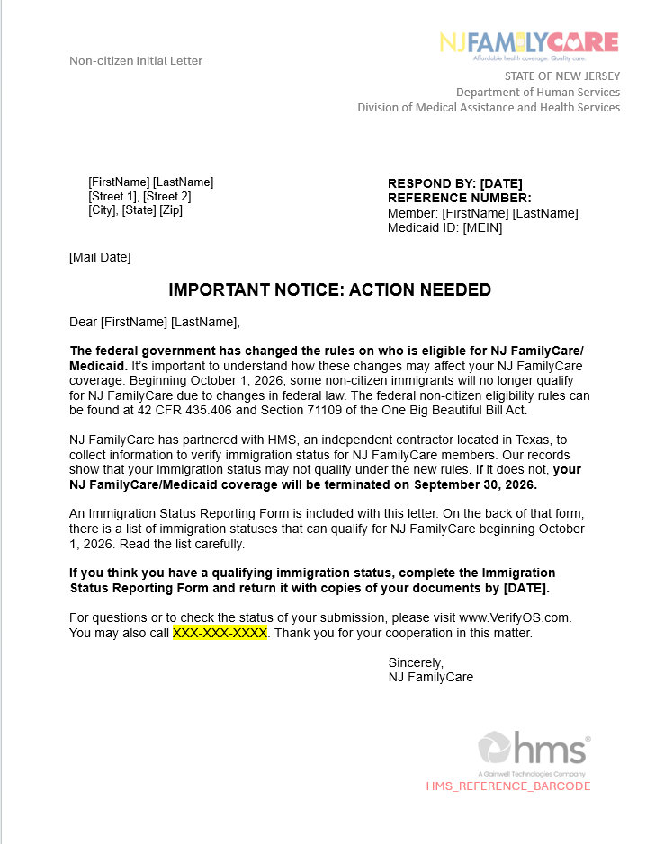
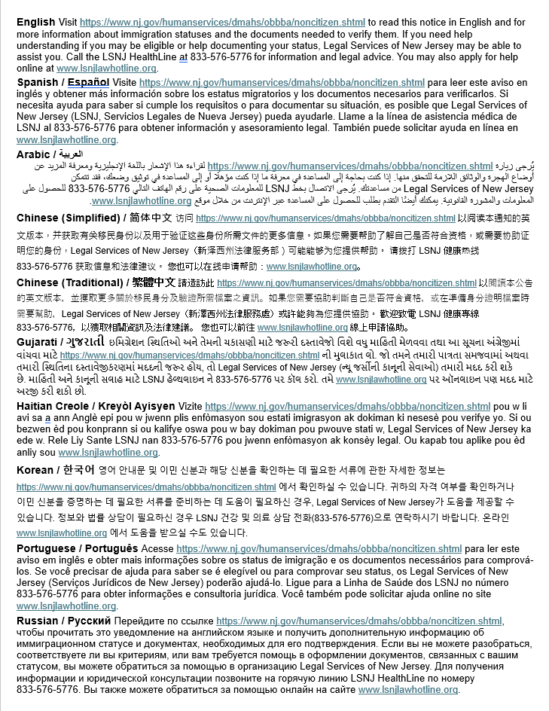
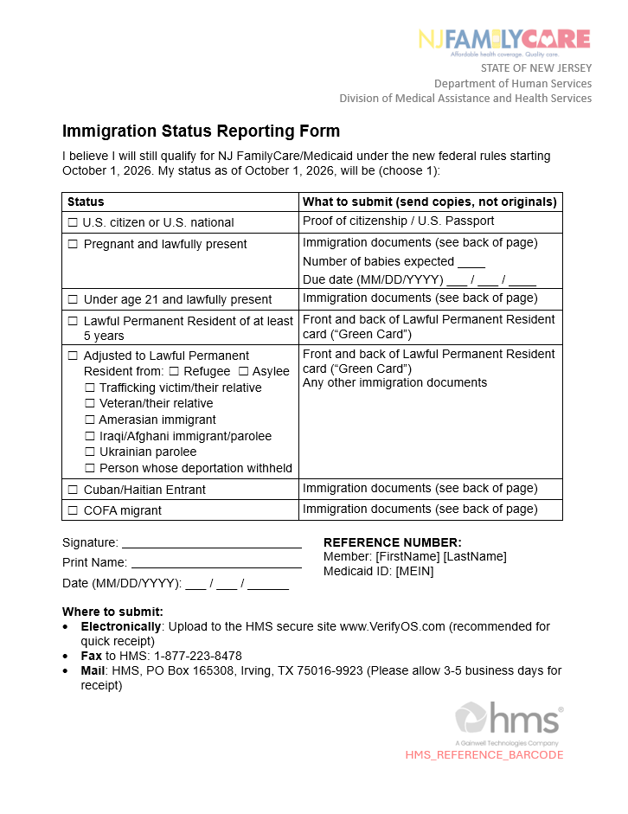
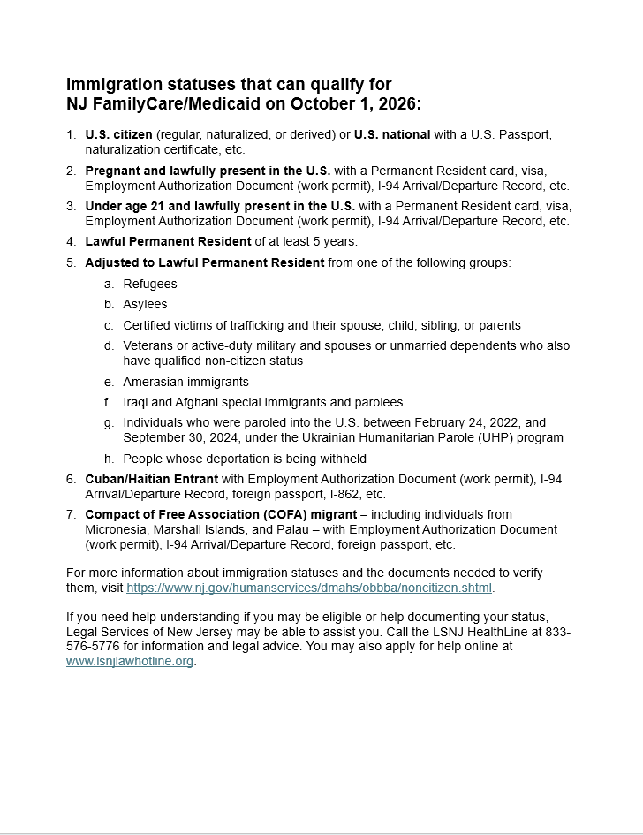
NJ FamilyCare outreach | The Initial Letter provides a comprehensive set of instructions for members to submit their documents
  Cover Page
  Explains the change in law and requests for member to submit documents
  Includes the HMS hotline to contact with questions
  Includes the member's HMS reference ID to log into the document submission portal
  Taglines
  Provides information in other languages on where to get translated resources, including a translated version of this letter
  Immigration Status Reporting Form
  Serves as member attestation to still-eligible status
  Tells members what documents to submit depending on what status they attest to
  Includes instructions on where and how to submit documents
  Qualifying Immigration Statuses
  Outlines what immigration statuses qualify for coverage on October 1
  Routes member to the Non-citizen Eligibility webpage for more information, and to Legal Services of New Jersey (LSNJ) hotline for legal assistance
j
Notes:
Let's look at what that first letter actually looks like, so you can recognize it right away. It's got four parts: a cover page that explains what's changing and what to send in, plus a hotline number and the person's reference ID; a page pointing people to translated versions in other languages; the actual Status Reporting Form they fill out; and a page listing which statuses qualify, with a link to legal help.
Good to know — this letter goes out in English and Spanish to everyone, and that translations page tells people how to get it in Arabic, Chinese, Gujarati, Haitian Creole, Korean, Portuguese, and Russian. So language shouldn't be what costs someone their coverage.

Slide 16
How to verify eligibility
1
2
Complete the “Immigration Status Reporting Form”
Identify the specific eligibility documents needed to submit on the "Immigration Status Reporting Form" and make copies of them
3
Submit the documents above in one of four ways
FASTEST / RECOMMENDED
Electronically via www.VerifyOS.com using the “Reference ID number” in the letter
Fax: 1-877-223-8478
Mail: HMS, PO Box 165308, Irving, TX 75016-9923
In person: Walk into any Eligibility Determining Agency – find them in your county here NJ FamilyCare - Need Help Enrolling?
IMPORTANT TO NOTE
NJ FamilyCare hired a company called HMS to handle this process, so enrollees will interact with HMS.
Notes:
Okay, so someone's got the letter — now what? Three steps. First, figure out which documents the form is asking for and make copies. Second, fill out the form. Third, send it in — four ways to do that: fastest is online at VerifyOS.com with their reference ID, or fax, mail, or walk it into any Eligibility Determining Agency in person.
One thing to know so nobody's thrown off — NJ FamilyCare hired a company called HMS to handle this whole process. So when someone calls that number or logs into that site, they're talking to HMS, not the state directly. That's normal, not a red flag.

Slide 17

Individual did not get a letter from NJ FamilyCare
If no letter, it could be because:
  NJ FamilyCare confirmed eligibility, so they did not need to send a letter.
  NJ FamilyCare could not confirm eligibility and sent a letter, BUT the individual did not receive.
Call the HMS Helpline. HMS has a list of everyone who was supposed to receive a letter and can verify.
If an individual is on the list, HMS can provide another copy of the letter and provide a reference number. A downloadable standard copy of the letter is available from the NJFamilyCare Non-Citizen Eligibility webpage (QR code here)
Notes:
You're going to get this question a lot: "I never got anything — am I okay?" Two options here. Either they sent a letter and it got lost — wrong address, whatever — or NJ FamilyCare already confirmed they're eligible and never needed to send one.
Either way, same answer: call the HMS Helpline. They've got the full list of who was supposed to get a letter and can tell you which case you're in. If someone's on that list, HMS can send a copy and a reference number — or there's a standard copy you can download from the Non-citizen Eligibility webpage.

Slide 18
Mistakes can happen
Scenario 1: Individual submitted documents and NJ FamilyCare sends a follow up/outcome letter that states ineligibility. What to do:
  Appeal the decision. Follow the instructions to appeal in the letter or contact Legal Services of New Jersey.
  If appeal deadline is missed, reapply to NJ FamilyCare by submitting a new application.
Scenario 2: Documents were not submitted, and the individual did not respond to the final termination notice for whatever reason.
  Reapply to NJ FamilyCare by submitting a new application.
Notes:
Let's talk about when things go wrong, because they will for some people. Scenario one: someone sent their documents in, and NJ FamilyCare still says not eligible. What do they do? Appeal — follow the instructions in the letter or call Legal Services of NJ. If they miss that window, they can just reapply with a new application.
Scenario two: nobody sent anything in, and the final notice went unanswered too. Same fix — reapply. What I want you to walk away with — there's always a next move. Nobody's stuck just because a step got missed.

Slide 19
SECTION 4
6 steps to help keep coverage
What immigrants can do right now

Slide 20
6 steps for immigrants to keep Medicaid
5 steps for immigrants to keep Medicaid
1
2
Open all mail & lookout for letter in July
Even if it looks like junk mail, open it. Sign up with the USPS for a free, daily email that tells you what mail is coming to your house soon. Sign up at: https://www.usps.com/manage/informed-delivery.htm
Keep documents organized
Put Medicaid letters in one place — a folder, binder, or envelope. Separate important mail from junk. Note deadlines.
3
4
Read notices carefully
Read every notice to understand what is changing, when it changes, and action steps needed. If it's not in their language, go back to the taglines in the letter for translation resources.
Send documents
If Medicaid asks for paperwork, send it — even if unsure about eligibility. Sending documents does not hurt the individual. It may keep coverage.
5
6
Request texts and emails
If the individual remains eligible, request future messages from NJ FamilyCare via text and email
https://dmahs-nj.my.site.com/addressupdate/
Appeal if needed
If coverage is cut and the individual disagrees, they have the right to appeal. Submit a 'Request for Fair Hearing.' Free legal help is available (see next slide).
Notes:
One —OPEN ALL MAIL RULE!! open all mail, especially anything official in July. Even if it looks like junk, open it. Two — keep documents in one place, a folder or envelope, this way they aren’t scrambling later. Work with people to try to find a system to keep things organized. Three — read every notice carefully so they know what's changing and what action steps are needed. Four —advice folks to send documents if they asked, even if unsure about eligibility. Sending them never hurts, in fact, it might be exactly what saves the persons coverage. Five — if your coverage gets cut and you don't agree, you can appeal — a Request for Fair Hearing — and there's free legal help for that.
Six —if the individual is still eligible, advise them to sign up for text and email updates via the dmahs website so they don't miss anything.
These are all actionable steps we can take right now with the people in our community who are affected. If I had to pick one, it's number four. Most people don't lose coverage because they're actually not eligible — they lose it because they never sent anything in. Usually fear, or overwhelm, or the letter wasn't in their language. Sending documents is never the wrong call.

Slide 21
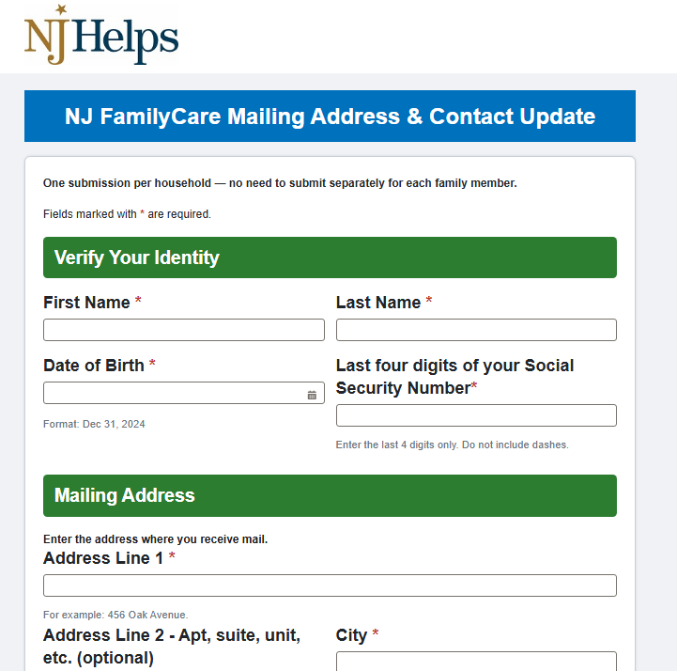
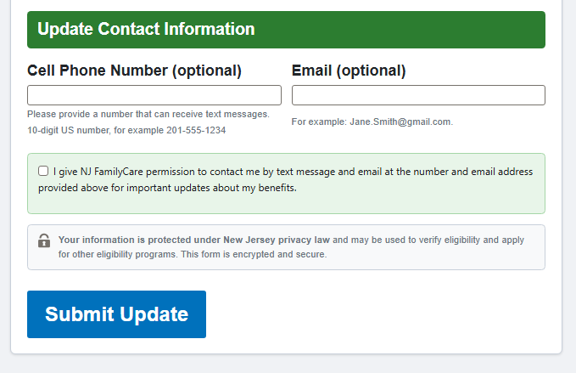

What the contact info update webpage looks like
Notes:
So remember step 5, "sign up for texts and emails"? This is that page. Let me show you what it actually looks like so nobody's hunting around for it later. This matters more than it sounds — if someone's address is wrong, that July letter goes to the wrong place. Updating your info here is just prevention.

Slide 22
Resources and Helplines
Legal Services of NJ HealthLine
NJ FamilyCare Non-Citizen
Eligibility webpage
1-833-576-5776 (TTY:711)
This new HealthLine provides free legal advice to help understand eligiblility, what documents to submit, how to appeal a decision and how to access free/low-cost health care services.
Use this QR code to visit the NJ FamilyCare
Non-Citizen Eligibility webpage
HMS Helpline
Others to contact
1 833-635-7060 (TTY:711)
This new Helpline walks through which documents to send, can resend letters, provide reference number, and verify whether documents were received.
Established health care provider
Other trusted community helpers such as people from places of worship, community groups, etc.
Health plan — find the 1-800# on the back of your insurance card
Notes:
Two numbers worth knowing. The Legal Services of NJ HealthLine — brand new, free legal advice on eligibility, what to send in, how to appeal, and finding low-cost care. And the HMS Helpline, which walks people through exactly what documents to send, can resend letters, give reference numbers, and confirm whether something got received. HMS goes live mid-July, we will share that information as soon as we have it.
Beyond that — a healthcare provider, someone trusted in the community, or the number on the back of someone's insurance card all work too. You don't have to know everything. You just have to know who to point people to.

Slide 23

NJ FamilyCare materials to help immigrants with the Medicaid eligibility process
Immigrant Document Guide
Live Member Support Resources
Information about required documents to be submitted with applications.
HMS hotline, LSNJ hotline, and Conduent call centers — trained navigators to help members through the process.
Flyer
FAQs for Impacted Immigrants
Shareable flyer for providers and primary care offices to post or distribute to patients.
Frequently asked questions for non-citizen immigrants navigating the eligibility changes.
Notice Templates
NJ FamilyCare Application Assistance Training
Examples and templates of the notice's members will receive from NJ FamilyCare or MCOs.
Updated training for those helping members apply. Request a flyer or graphic to promote it.
Overall eligibility changes: nj.gov/humanservices/dmahs/obbba/medicaid-federal-changes.shtml
Non-citizen specific eligibility changes: nj.gov/humanservices/dmahs/obbba/noncitizen.shtml
Notes:
Here are a few resources/materials that DMAHS has put together to help — a document guide that spells out exactly what's needed, a flyer for provider offices, an FAQ sheet, notice templates so you know what letters look like, live support through the HMS, LSNJ, and Conduent call centers, and updated training for anyone helping people apply.
These resources can be found on the NJFC Non-Citizen Eligibility webpage after July 20.
Bookmark the DMAHS page — it gets updated a lot. If you only grab three things: the document guide, the notice templates, and the flyer for your office.

Slide 24
Actions you can take
Examples of how to support community members that can and will be affected by these changes

Slide 25
Guiding NJ FamilyCare members through the documentation process
On an Organizational Level:
Sign up for a new DMAHS listserv to stay informed about HR1 changes – get policy updates, new resources, and answers to common questions as they become available. Send an email to this address and ask to be added: MAHS.FederalChanges@dhs.nj.gov.
Check out the Camden Coalition’s new webpage: South Jersey Work Group on HR1 Medicaid Changes & More
Conduct this training for your staff and partner organizations – and report it to the Camden Coalition.
Advertise to your clients you can help them with this process by posting on social media, hanging signs in your office, etc.
Pro-actively and discretely identify clients you believe must go through this process by asking them if they received a letter from NJ FamilyCare and/or asking other screening questions.
Dedicate part of a staff member’s time to assist clients who request help with the process if possible.
On an Individual Level:
Explain the overall process using the instructions in their Initial Letter and guide them to complete their Immigration Status Reporting Form. If they are in person, help them submit their documents by uploading them into the HMS portal / VerifyOS.com or faxing them.
For more help, direct them to the dedicated state webpage: Federal Changes to Non-citizen Eligibility for NJ FamilyCare / Medicaid | Division of Medical Assistance and Health Services and to other support organizations — especially the Legal Services of NJ dedicated HealthLine: +1 833-576-5776 (TTY: 711).
For clients who are no longer eligible:
  Encourage them to use their coverage while enrolled – go to the dentist, get medication refills, get their eyes checked and possibly new glasses, etc.
  Connect them to the NJ Marketplace, GetCovered NJ, and help them determine if they can afford the coverage or refer them to an insurance assistor to do this at this link.
  Connect them to free and low-cost health care services via the online directory called My Resource Pal.
Notes:
On the org side — sign up for the new DMAHS listserv so you get updates as they come, check out the Camden Coalition's South Jersey Work Group page, run this training for your own staff and partners, and let your clients know you can help — post about it, put up a sign, whatever fits. It also helps to just ask people directly if they got a letter from NJ FamilyCare. And if you can, set aside some staff time to help people through this.
On the individual level — walk someone through their letter, help them fill out the Status Reporting Form, and if they're in front of you, help them actually submit it through the portal or by fax. Point them to the state webpage and especially the LSNJ HealthLine for anything more.
And for anyone who ends up losing coverage — tell them to use it while they still have it. Go to the dentist, refill meds, get eyes checked. Then connect them to GetCovered NJ to see if it's affordable, and to My Resource Pal for free and low-cost care.

Slide 26
SECTION 5
Privacy & safety
What immigrants need to know about their personal information

Slide 27
Privacy concerns
Data sharing is happening
Protecting others in your household
Federal agencies (USDA, HHS) have made efforts to share public benefit data with the Department of Homeland Security (DHS/immigration). Efforts to stop this are ongoing in courts — but not fully resolved.
When applying for benefits for children, you are NOT required to provide immigration status or Social Security numbers for household members who are NOT applying. An undocumented parent can apply for her U.S. citizen child without disclosing her own status.
What
we
Should someone withdraw from benefits?
know
Ultimately, it's a personal decision
Withdrawing now does NOT remove your information from records the government already has. If DHS already has your address through immigration filings, applying for benefits does not create additional new risk.
Benefits can be life-saving. The decision about applying — weighing the value of health coverage against privacy concerns — belongs to each individual and family. Help them understand the real risks and real benefits so they can decide.
Source: Philadelphia Community Legal Services; Protecting Immigrant Families coalition (pifcoalition.org)
Notes:
Some federal agencies have tried to share benefits data with DHS. Courts are fighting that, but it's not fully settled. It’s not possible to guarantee there's zero risk, because we don’t know that right now.
What is true is: when you apply for benefits for a child, you don't have to give up your own status or Social Security number if you're not the one applying. An undocumented parent can apply for their U.S. citizen kid without saying anything about themselves.
And on the "should I withdraw" question — that's personal, and it's not mine to answer for anyone. But here's a fact that helps: withdrawing now doesn't erase info the government already has. If DHS already has someone's address through another filing, applying for benefits doesn't add new risk. Benefits can be life-saving. Our job is to help people weigh the real risk against the real benefit — not decide for them.

Slide 28
How to talk with immigrant families
5 steps for immigrants to keep Medicaid
Key messages to share — in plain language
1
2
If you are already receiving benefits, your information is already in government records. Withdrawing now doesn't erase that.
If DHS already has your address (through an asylum or other immigration application), applying for benefits doesn't create new risk.
3
4
You do NOT have to share your immigration status or Social Security number for family members who are NOT applying for benefits.
Benefits programs can be very valuable and even life-saving. Weigh the value of health coverage against your concerns and make the choice that is right for you and your family.
5
You are not alone. Free legal help and community support is available to help you make this decision.
Notes:
This slide's basically a script — actual words you can use. If someone's already getting benefits, their info's already in the system — withdrawing now doesn't undo that. If DHS already has their address through another process, applying doesn't add new exposure. They don't have to share their own status or Social Security number for family members who aren't applying. Benefits can be genuinely life-saving, so it's worth weighing that against the worry. And they're not alone — free legal help and community support exist for exactly this.
Your job here is never to tell someone what to do. It's to give them straight, accurate info so they can make their own call.

Slide 29
SECTION 6
Case studies
Let's practice with real scenarios

Slide 30
Case study 1
Discussion: What would you tell Maria?
M
Maria
✓ KEY POINTS
Humanitarian parolee
Maria (humanitarian parolee) will likely lose Medicaid on October 1, 2026.
Her children (U.S. citizens) will NOT lose Medicaid — their eligibility is separate from hers.
She should ask for help and respond with documents by the deadline.
She should be connected to free legal help, application assistance for the GetCovered NJ Marketplace, and resources for free and low-cost care at My Resource Pal.
35-year-old woman
Came to the U.S. from Honduras 3 years ago
Has 2 US-born children — ages 2 yrs old and 2 months old (US citizens)
Family currently receives Medicaid
Received a letter from NJ FamilyCare that she doesn't understand. She's scared to call anyone because she's afraid it will get her in trouble.
Notes:
Maria's 35, came from Honduras three years ago, has two U.S.-born kids, and the family's on Medicaid. She got a letter she doesn't understand and she's too scared to call about it.
What do you tell her? As a humanitarian parolee, she's probably losing her Medicaid October 1st — but her kids are fine, since their eligibility has nothing to do with hers. What she needs to do is ask for help and get her documents in by the deadline. Get her to free legal aid, help applying to GetCovered NJ, and My Resource Pal for low to no cost care. Her fear's real, but it shouldn't stop her from acting.

Slide 31
Case study 2
Discussion: What would happen next?
✓ KEY POINTS
A
Ahmed
Good news: Refugees who adjusted to LPR (have a green card) KEEP their Medicaid coverage. Ahmed is NOT in the losing group.
However, he must respond to the notice to confirm his eligibility
Help him contact the HMS Helpline to request a copy of his letter - or he can download a copy of the letter from the new NJ FamilyCare “Non-citizen Eligibility” webpage and submit his documents via fax, US mail or in person.
Coach him on the 'open all mail' rule - this situation shows why it matters - and encourage him to update his address and phone number if/when it changes using the NJ FamilyCare online Mailing Address and Contact Update form.
Refugee → Adjusted to LPR
52-year-old man
Came to the U.S. from Somalia 7 years ago
Currently receives Medicaid
Has diabetes and sees specialist regularly
Received the initial letter in July that he threw away because he thought it was junk mail. It’s now August and he hasn’t done anything yet.
Notes:
Ahmed's 52, came from Somalia seven years ago as a refugee, is on Medicaid, manages diabetes. He got his letter in July, thought it was junk mail, and tossed it. It's August now and he hasn't done anything.
Good news — he already got his green card, so he's not in the losing group, he keeps his Medicaid. But he still needs to respond to confirm it. Help him call the HMS Helpline for a new copy of the letter, or download one from the webpage, and get it in by fax, mail, or in person. Great moment to reinforce "open your mail" — even people who are fully protected can hit trouble just by not responding. And while you're at it, get him to update his contact info so this doesn't happen again.

Slide 32
Case study 3
Discussion: How do you respond to Yolanda's concern?
Y
Yolanda
✓ KEY POINTS
Undocumented
Acknowledge her fear — it is valid. Share what is known about data privacy without making promises. Refer her to a legal aid organization for personalized guidance.
Yolanda does NOT need to share her own immigration status to apply for Carlos — only Carlos's information is required.
Carlos's coverage is not affected by his mother's status. He has asthma and not having medication puts him at real medical risk.
The decision is hers. Your job is to make sure she has accurate information to decide.
Never applied for Medicaid for herself
Has an 8-year-old US-born son, Carlos, who qualifies for Medicaid
Carlos has asthma and needs regular medication
Heard on social media that if she applied for Medicaid for Carlos, ICE will get her address. She has not renewed Carlos’s coverage and is afraid.
Notes:
Yolanda never applied for Medicaid for herself. Her 8-year-old son Carlos, a citizen, qualifies and needs regular asthma meds. She heard on social media that applying for Carlos would get her address to ICE, so she hasn't renewed his coverage, and he's going without medicine.
How do you respond? Start by saying her fear makes sense — it's not crazy to feel that way. Share what's actually known about privacy without promising things you can't back up. Then get concrete — Yolanda doesn't need to say anything about her own status to apply for Carlos, only his info matters, and his eligibility has nothing to do with hers. Point her to legal aid for a real conversation about the risk. But don't lose sight of what's at stake — Carlos needs his medicine right now. It's still her call to make, but she deserves good info to make it with.

Slide 33
What if someone loses Medicaid
Community Health Centers (FQHCs)
NJ GetCovered / Marketplace
Immigrants who lose Medicaid will qualify for the NJ health insurance marketplace (NJ GetCovered). However, not all of them will qualify for financial help to pay for the coverage. Some will pay the full cost. This is worth exploring but may not be affordable.
Federally Qualified Health Centers offer care on a sliding-fee scale, regardless of immigration or insurance status. This is often the best option for ongoing primary care for uninsured immigrants.
Losing Medicaid does not mean losing all access to care. Here are some other options to consider.
Prenatal and Family Planning Services
Medical Emergency Payment Program (MEPP)
Free & Low-Cost Care (My Resource Pal)
The New Jersey Supplemental Prenatal and Contraceptive Program provides prenatal and family planning services to women who do not qualify for NJ FamilyCare because of their immigration status. Access the program at a Community Health Center. More information here - https://njfamilycare.dhs.state.nj.us/njspcp.aspx.
MEPP provides emergency medical coverage for immigrants who do not qualify for full Medicaid. It covers acute emergency care and crisis situations, including labor and delivery for undocumented pregnant people. It is not full coverage, but it is a critical safety net when no other coverage is available.
Use tools like My Resource Pal to find free and low-cost primary care, mental health, dental, vision, and reproductive health care near you. Your organization may have a community health worker who can help.
Notes:
Community Health Centers, or FQHCs, offer care on a sliding scale no matter your immigration or insurance status — usually the best bet for regular primary care. The Medical Emergency Payment Program covers emergencies for people who don't qualify for full Medicaid, including labor and delivery for undocumented pregnant people — not full coverage, but a real safety net. GetCovered NJ, the Marketplace, is worth looking into too, though not everyone gets help paying for it. And My Resource Pal can help find free or cheap primary care, mental health, dental, vision, and reproductive care nearby.
The thing to remember here — losing Medicaid does not mean losing access to care.

Slide 34
Can immigrants use the Health Insurance Marketplace?
Some immigrants who lose Medicaid may qualify — and some will pay full cost, no subsidies.
Immigrant Eligibility for Marketplace Insurance
 | Now | January 2027
Eligible for Marketplace coverage | All lawfully present individuals | All lawfully present individuals
Eligible for Marketplace federal financial help (subsidy) | Lawfully present individuals with income between 100 – 400% of the federal poverty level | Some lawfully present individuals with income between 100 - 400% of the federal poverty level: 1) Lawful Permanent Residents (LPRs), 2) Cuban/Haitian entrants, 3) COFA migrants (from Micronesia, Marshall Islands, Palau)
Not eligible for Marketplace federal financial help (subsidy) | Lawfully present individuals with income below 100% of the federal poverty level DACA recipients (Deferred Action for Childhood Arrivals or Dreamers) | Lawfully present individuals with income below 100% of the federal poverty level DACA recipients (Deferred Action for Childhood Arrivals or Dreamers) Lawfully present individuals with income between 100 – 400% of the federal poverty level who are not in the 3 groups in the row above
What is the Marketplace?
In New Jersey it is called GetCovered NJ (getcoverednj.com). It the same as the Affordable Care Act and Obamacare. It is where people can buy health insurance if they do not have it through work or Medicaid.
Jan 1, 2027
⚠ Important:
Immigrants who lose Medicaid due to HR1 qualify for Marketplace insurance — but those with the smallest incomes, under 100% of the federal poverty level, will NOT get subsidies to help pay for it. They pay the full premium, which can be very expensive.
Sources: State Health & Value Strategies and GetCovered NJ
Notes:
Right now, any lawfully present person can get Marketplace coverage, and if you're between 100–400% of the federal poverty level, you can get help paying for it. Starting January 2027, that gets narrower — only LPRs, Cuban/Haitian entrants, and COFA migrants in that income range still get the subsidy.
People under 100% of poverty level, which is often the lowest-income folks losing Medicaid, get zero help paying for it. Full price. For most families, that's just not realistic. So while the Marketplace technically works, for a lot of folks we're talking about today, FQHCs are the more realistic path.

Slide 35
TOOL SPOTLIGHT
My Resource Pal
A free tool to find insurance navigators and free services near you
Notes:
My Resource Pal. It's free, built by the Camden Coalition, and it helps people find local navigators and services nearby. Especially good for anyone losing Medicaid who needs some hands-on help figuring out next steps.

Slide 36































What is My Resource Pal?
My Resource Pal is a free online tool that helps people in South Jersey find local programs and services — including insurance navigators, food assistance, mental health support, and more.
Search by zip code to find what's available near you. No login required, and no immigration status is asked.
Notes:
My Resource Pal helps people across South Jersey find local programs and services — insurance navigators, food help, mental health support, and more — all by zip code. No login, and it never asks about immigration status.

Slide 37

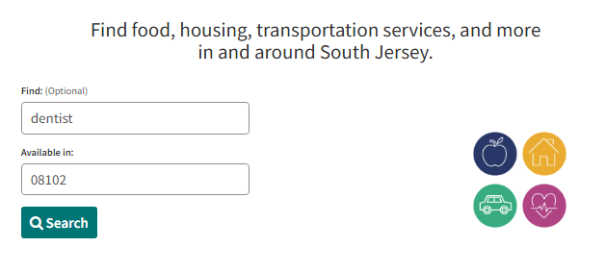

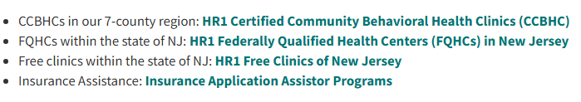
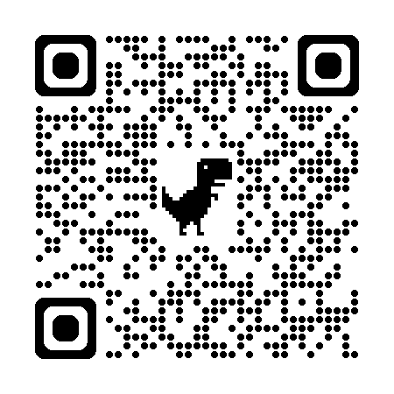
Searching My Resource Pal
Go to myresourcepal.org or use the QR code below
On the homepage, find shortcut links to community health centers and free clinics, mental health care and organizations that help people apply for insurance
To find these and many other types of services, enter a topic such as “dentist” and your zip code or town name
You’ll be directed to the main page which will populate a list of the service you selected
Notes:
Here's how it works. Go to myresourcepal.org or scan the QR code. The homepage's got shortcuts to health centers, free clinics, mental health care, and insurance help. Or just type what you need — like "dentist" — plus a zip code or town, and it pulls up what's nearby.

Slide 38

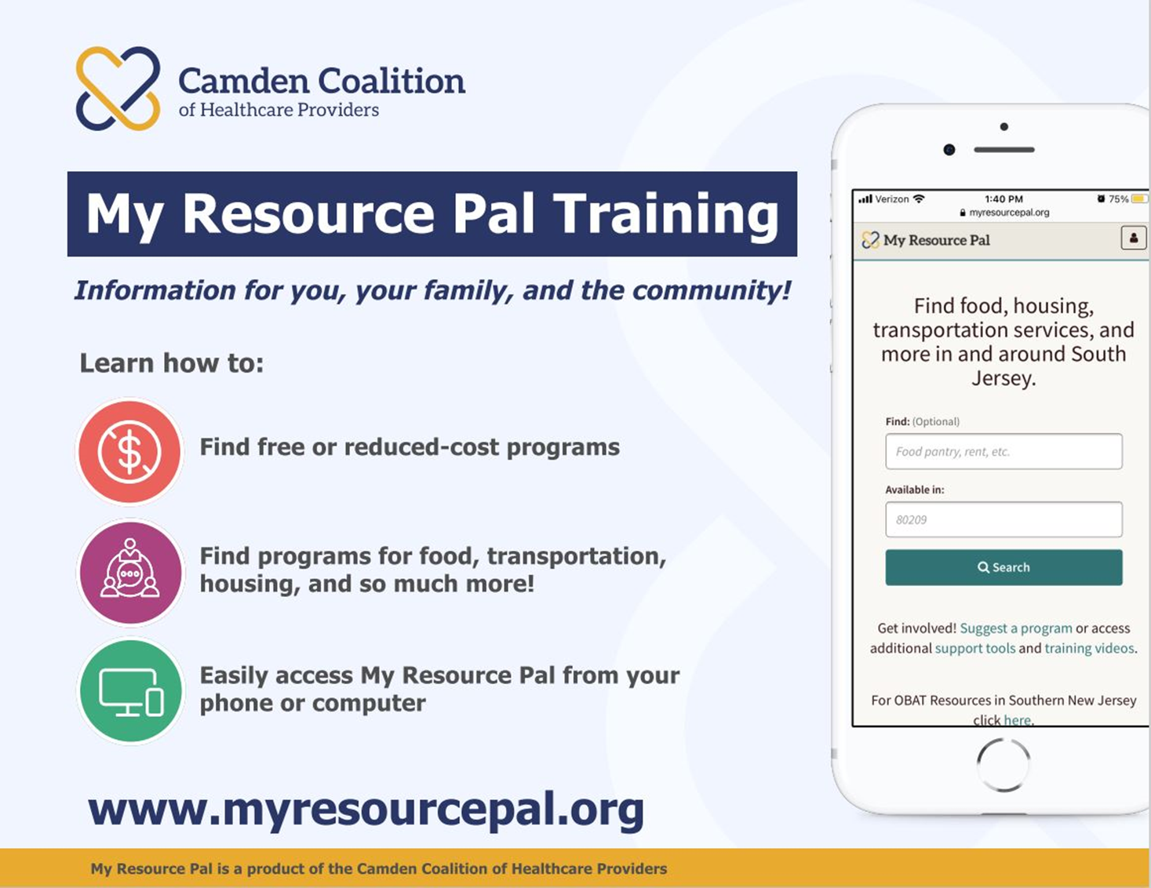
My Resource Pal team
Kerona Sharpe
Senior Program Manager,
My Resource Pal & Health Information Exchange
Want to learn more? myresourcepal@camdenhealth.org
Notes:
If you want to dig deeper on this tool for your org, Kerona Sharpe runs My Resource Pal and the Health Information Exchange — her info's right here if you want to connect after today.

Slide 39
On the horizon: Another HR1 change coming January 1, 2027
Today's training focuses on immigrants. But there is a second group you should know about.
Who is affected?
Very low-income adults (roughly those earning up to 138% of the Federal Poverty Level) who are currently on Medicaid. Starting January 1, 2027, these adults will face new work reporting requirements and will need to renew their Medicaid every 6 months instead of once a year. People who are deemed medically frail may be exempt — but the definition and process for that is still being determined.
This will likely be challenged
Work requirements for Medicaid have been struck down by courts before. Legal advocates are expected to challenge this in court. The rules may change significantly before January 2027.
What the law says
Why we are flagging it now
Adults must prove they are working, in school, volunteering, or qualifying for a medical exemption to keep Medicaid. They must also renew every 6 months — twice as often as before.
We don't have all the details yet — and they are likely to change. But your clients and patients need to know this is coming so they are not caught off guard. Stay tuned for updates.
Bottom line: Put this on your radar. We are not advising clients on specifics yet because the rules are still evolving and litigation is expected. Watch for updates from NJ DMAHS and your RHH. A separate training will follow when guidance is finalized.
Notes:
There's a second group affected by HR1 — very low-income adults, up to around 138% of poverty level, currently on Medicaid. Starting January 1, 2027, they'll have new work requirements and have to renew every 6 months instead of once a year. There's an exemption for people who are medically frail, but how that actually gets figured out is still up in the air.
Why am I only giving you the headline here? Because work requirements like this have gotten struck down by courts before, and legal challenges are expected again. Things could look pretty different by January. We're flagging it now so nobody gets blindsided, not because we've got final answers. A separate training's coming once things settle down.

Slide 40
On the horizon: Another HR1 change coming January 1, 2027
Today's training focuses on immigrants. But there is a second group you should know about.
Bottom line
Put this on your radar. We are not advising clients on specifics yet because the rules are still evolving and litigation is expected. Watch for updates from NJ DMAHS and your Regional Health Hub/RHH. A separate training will follow when guidance is finalized.
Notes:
Don’t get ahead of the guidance with clients yet, and keep an eye out for updates from DMAHS and your Regional Health Hub.
[Heads up: this slide repeats slide 39's content. Consider cutting one of the two so you're not saying the same thing twice live.]

Slide 41
Key reminders for healthcare & social care workers
5 steps for immigrants to keep Medicaid
Information is changing fast
Treat this like COVID: act urgently, and update your information as things change. Don't wait for the perfect answer — share what you know now.
Children and pregnant people are protected
Remind every family: children's eligibility is NOT affected. Pregnant people remain covered. If you are pregnant and you get a notice, submit the documents to let NJ FamilyCare know.
Help people respond to notices
The most important action is responding to Medicaid notices with documents. Help clients do this. If they don't know their status, connect them to legal aid to learn what documents to submit.
You are not alone in this
Connect with partners — legal aid, community health workers, health plans, and HMS. You don't have to have all the answers. Know who to call.
Don't share false reassurances
Avoid telling immigrants their data is 100% safe or that there is no risk. Be honest about what is known and unknown. Trust is built on accurate information.
This training is a starting point
Guidance is still evolving. Check the NJ Medicaid website for updates. Come back with questions. We'll keep updating this training as things change.
Notes:
Things are changing fast — treat this like COVID. Move with urgency, update as you go, and don't wait for the perfect answer before you share what you know. Kids and pregnant people are protected — say that to every family, every time. Helping people respond to their notices is the single biggest thing you can do — if someone doesn't know their status, get them to legal aid. You're not doing this alone — lean on legal aid, community health workers, health plans, HMS. You don't need all the answers, you just need to know who to call. And don't give false reassurance — never tell someone their info is 100% safe, because you don't know that. Be honest about what you know and don't know. That's what builds trust.
Last thing — this training's a starting point, not the finish line. so check the NJ Medicaid site, our working group webpage, and come back with questions anytime. We'll keep updating this as things move.

Slide 42

ONLINE LIBRARY OF RESOURCES
CamdenHealth.org
Scan the QR code to access resources and information about HR1 changes
Notes:
Everything we covered today, plus more, lives at CamdenHealth.org/hr1-Medicaid-changes — scan the QR code and you've got the whole thing in your pocket.

Slide 43
Questions and discussion
30 minutes — your questions, comments, and experiences matter.
?
What questions do you have about eligibility for specific immigration statuses?
?
What tools or support do you need to help your clients/patients with this?
?
What situations are you already seeing in your work with immigrant communities?
?
What would make it easier for immigrants you work with to take action?
Notes:
That's the training — now I want to hear from you. What questions do you have about specific statuses? What tools or support do you actually need to help your clients and patients with this? What are you already running into out there? And what would make it easier for the people you work with to actually take action?

